Slide 1
Notes:
1 minute per participant – total 10 mins

Slide 2
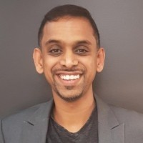
About Me
Judge
Multicultural Business Ministerial Council
P: +61 424 287 904
E: info@businessnirvana.com
Notes:
1 minute per participant – total 10 mins

Slide 5
Module1:
Learn To Lead 1 – Re-Cap

Slide 6
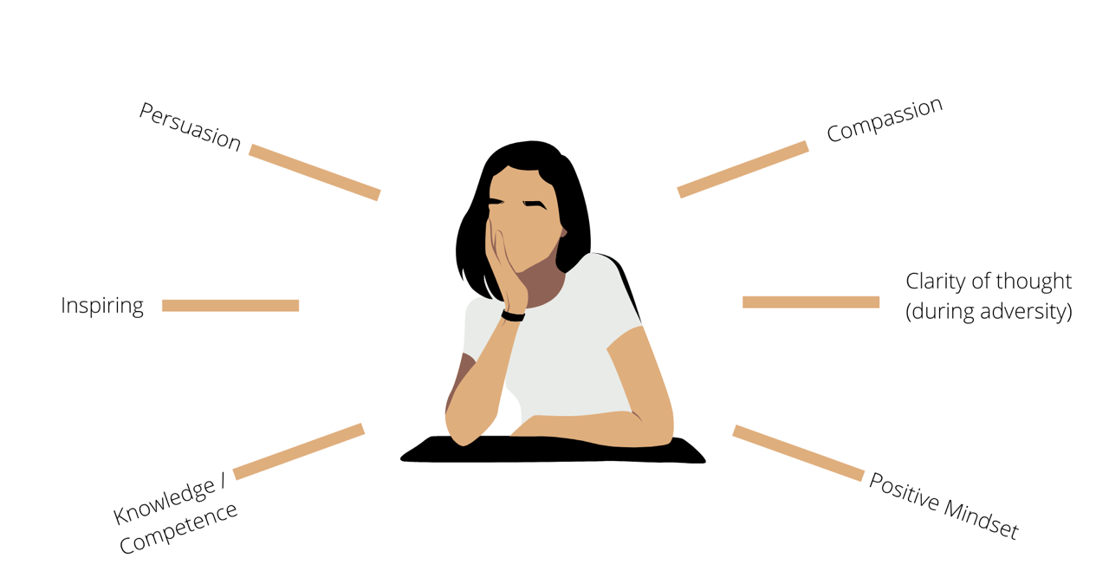
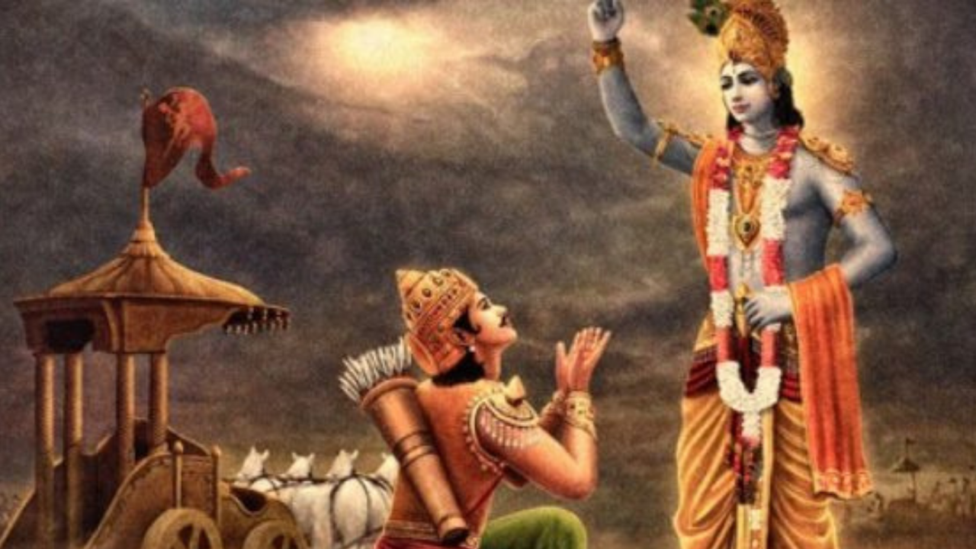
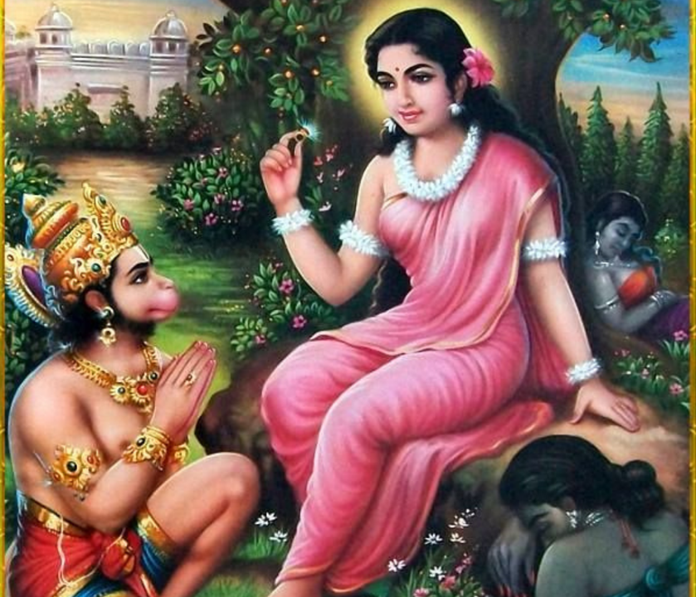
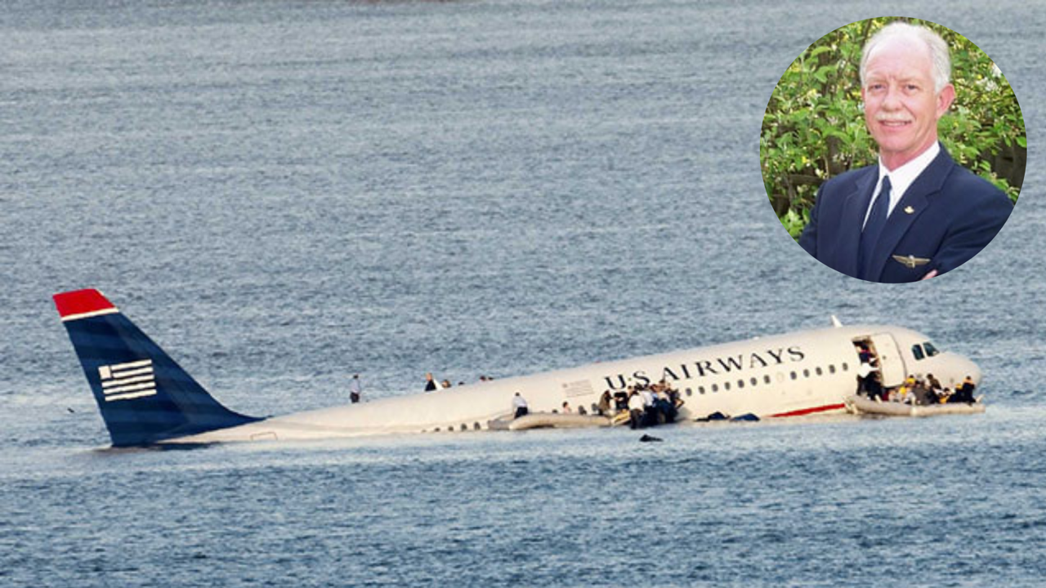
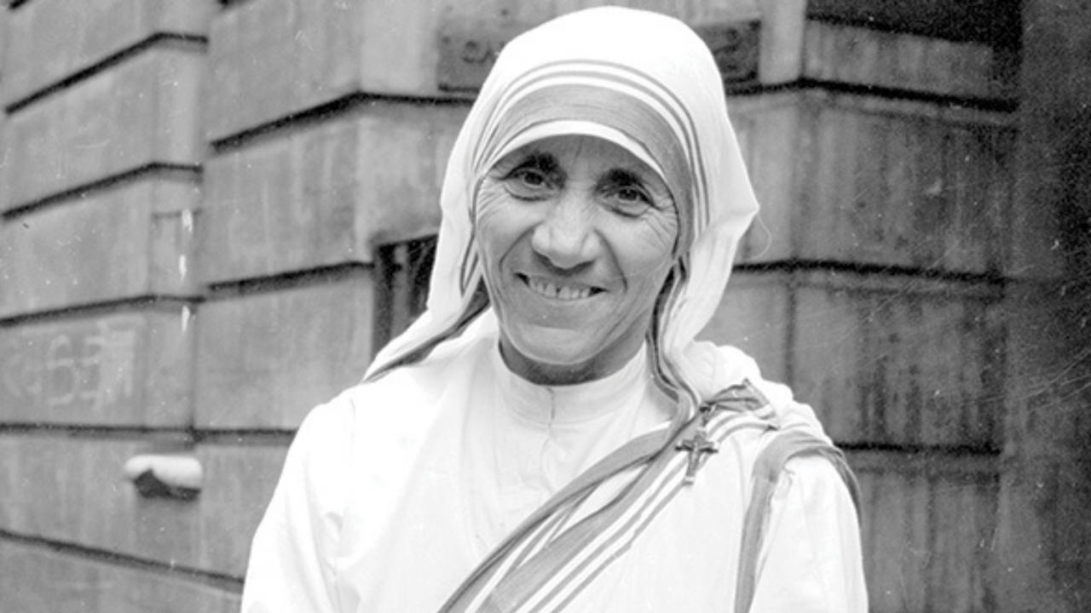
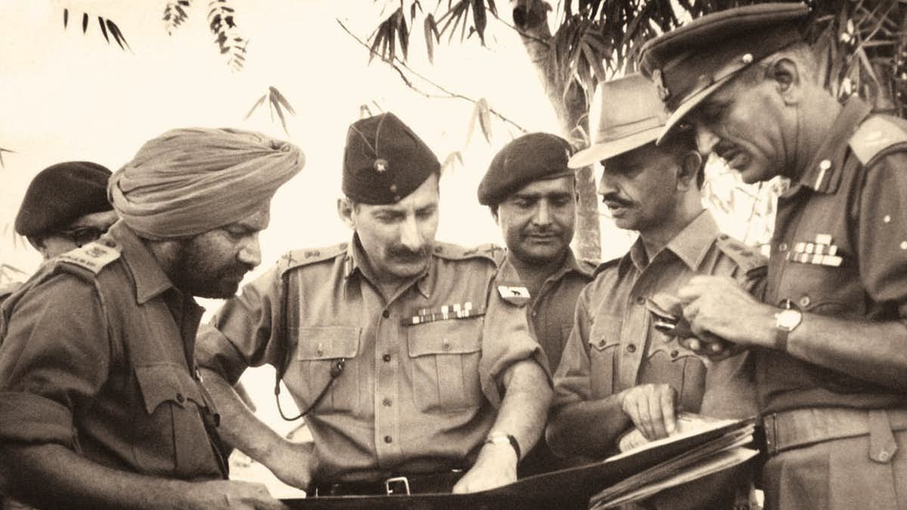
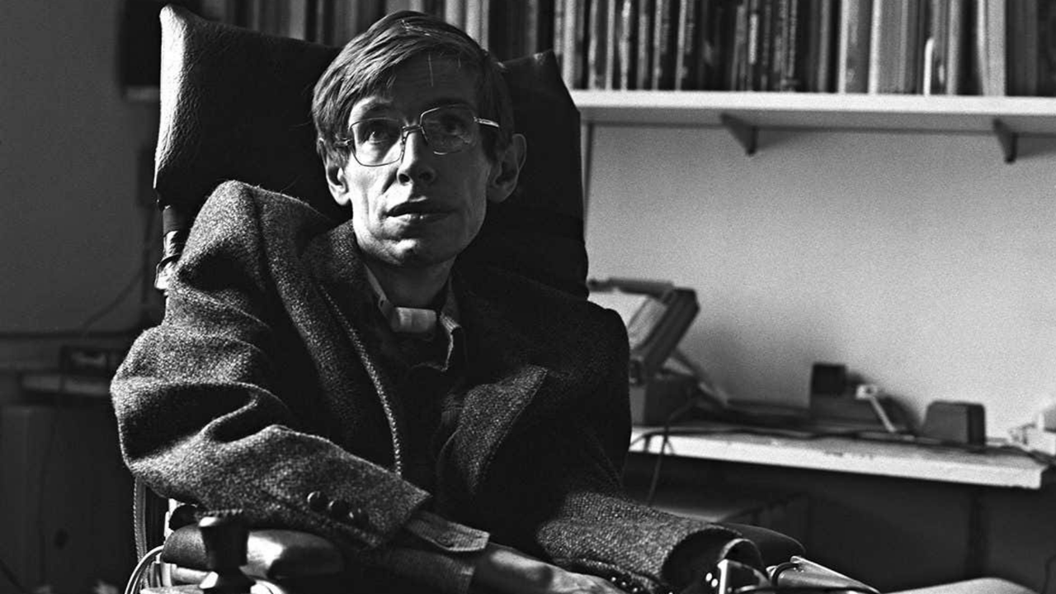
Stories of Exemplary Leadership
6
1
2
5
4
3

Slide 7
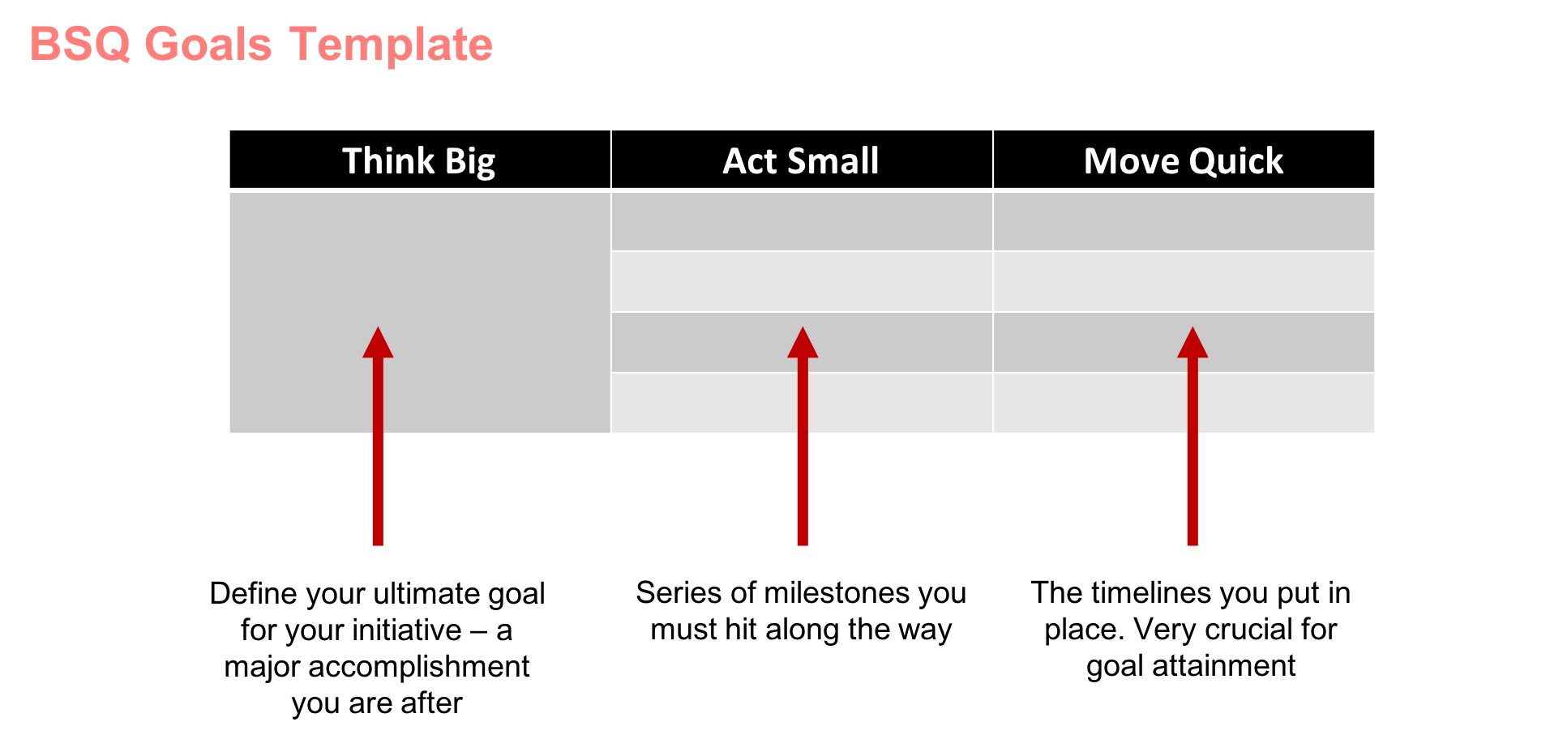
Vision & Goals

Slide 8
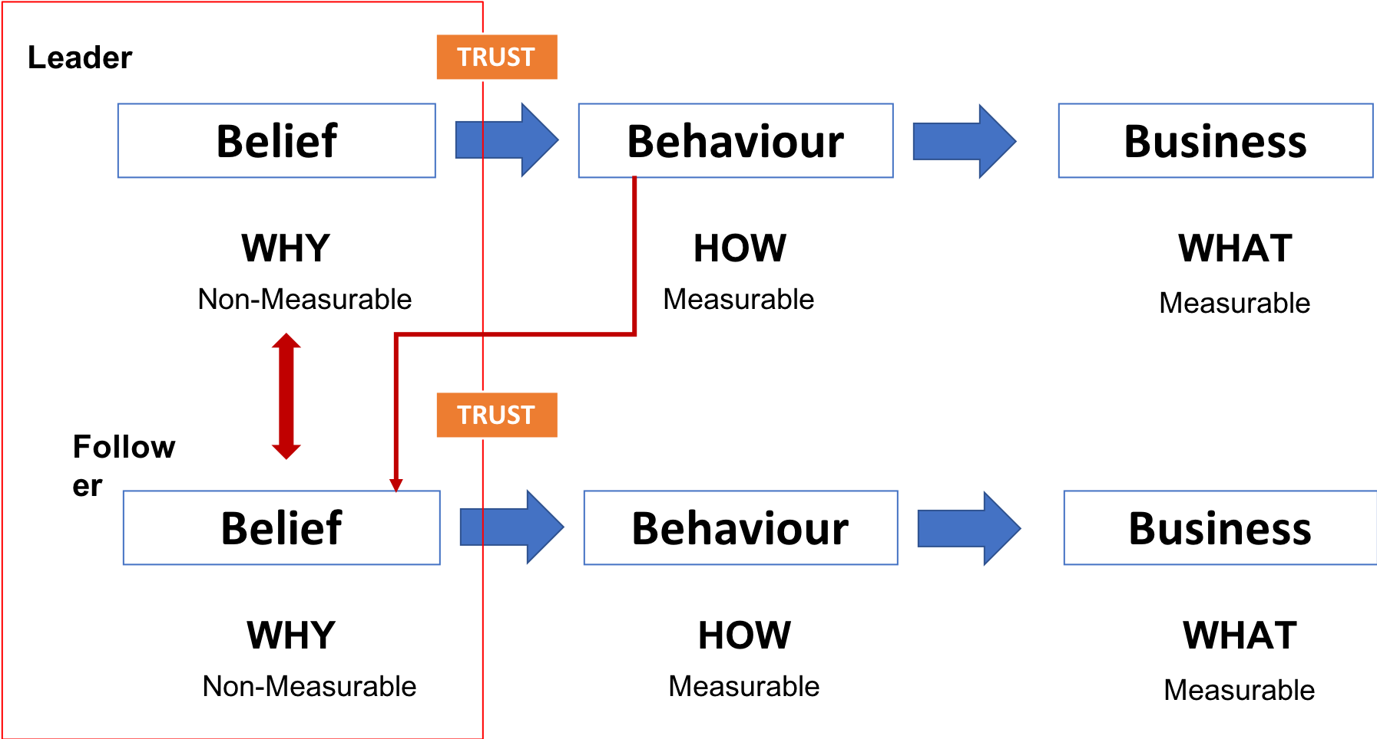
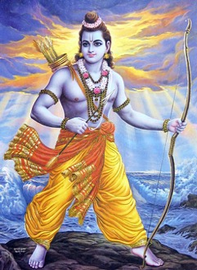
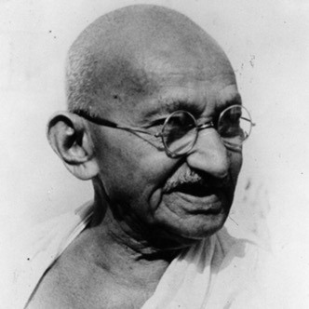
Belief in Leadership

Slide 9
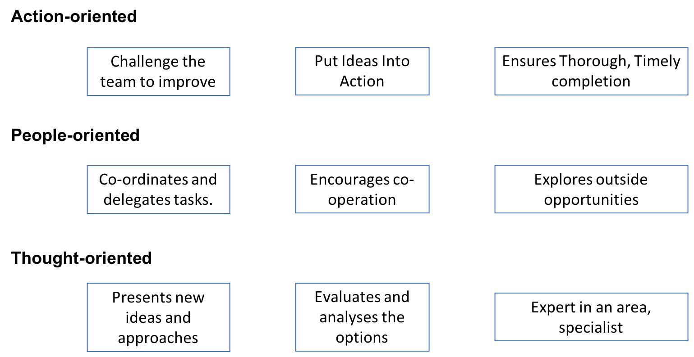
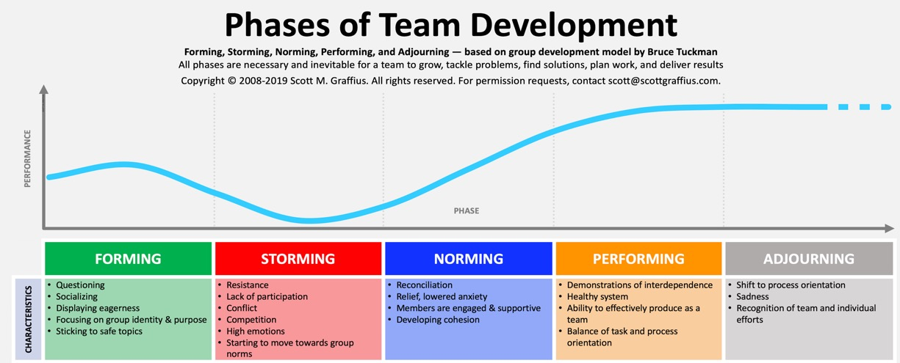
Teamwork

Slide 10
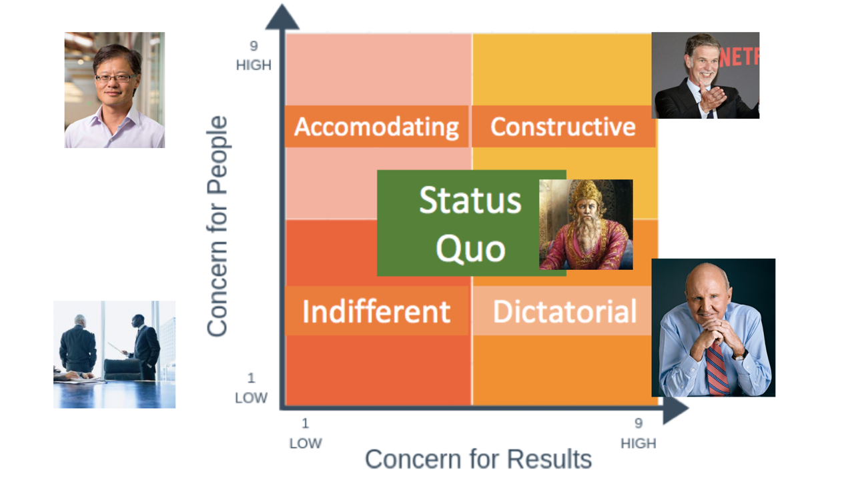
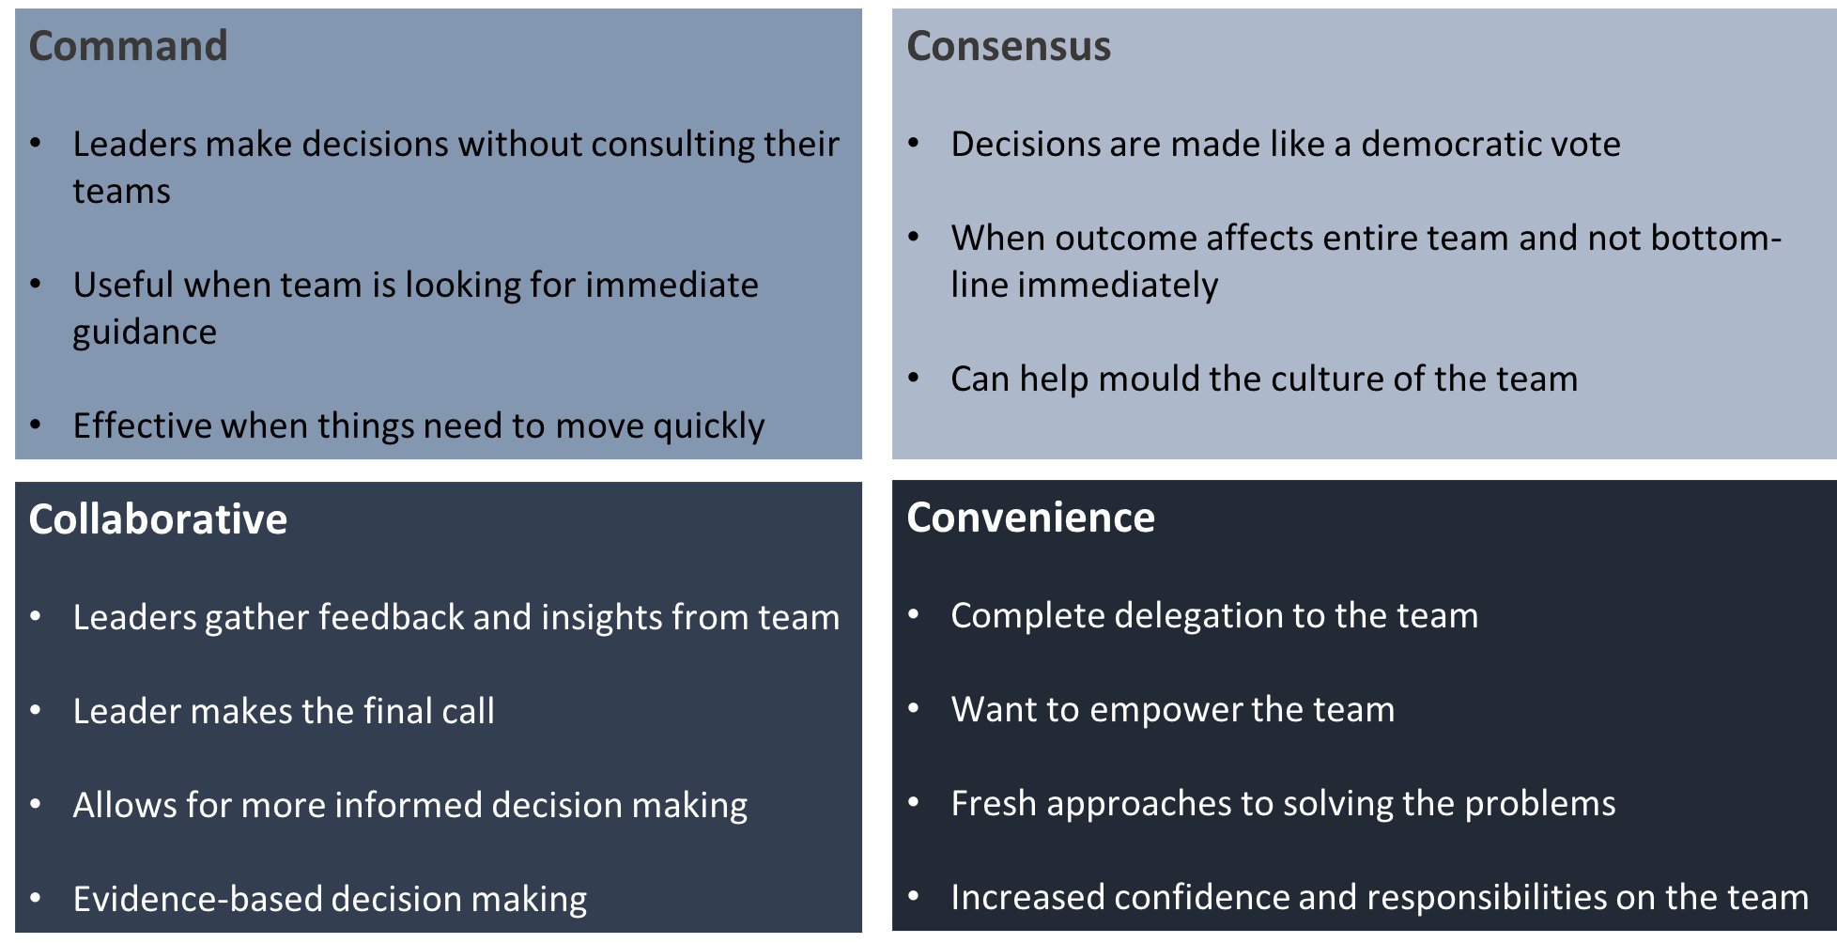
Decision-Making

Slide 11
Learn to Lead – Part 1: What did we learn?
Qualities of an ideal leader:
Compassion
Clarity of Thought
Positive Mindset
Knowledge / Competence
Inspiring
Persuasion
Vision: The 4-step test
Compelling
Image
Achievable
Future
Goals
Now-Where-How
BSQ Model
3B Leadership Framework: Belief in Leadership
Belief-> Behaviour->Business (Outcome)
Teamwork in Leadership
Belbin Team Roles
4 Stages of Teams
Decision-Making in Leadership
Leadership Styles
Types of Decisions
Notes:
1 minute per participant – total 10 mins

Slide 12
Learn to Lead – Part 2: The Project
Take the Now-Where-How model and fill in a ‘Where you would like to be’ in ONE WEEK
Using the BSQ goals model, fill in each of the stages and make a complete plan to achieve your ‘Where’. In the timeline, prepare a daily milestone.
Using the 3B model, identify & document the desired behaviours. And identify & document the beliefs you need to drive that behaviour. Use the six qualities of a leader and check against your beliefs.
Identify all the ‘team members’ that play ANY role (identify the role they play) in you achieving your ‘Where’. Document it.
Do a complete SWOT analysis relating your ‘Where’. Identify and document the key decisions you need to to make and the ones you took.
Next week, you will be required to present a 1-minute talk on the entire project on the ‘The Current state’, ‘What actions you took’ and the ‘Overall result achieved’.
1
2
3
4
5
6
Notes:
1 minute per participant – total 10 mins

Slide 13
Module 2:
SWOT and Decision-Making

Slide 14
The SWOT
STRENGTHS
OPPORTUNITIES
THREATS
WEAKNESSES

Slide 15
SWOT and Decision-Making
STRENGTHS
OPPORTUNITIES
THREATS
WEAKNESSES
How can I use my strengths to take advantage of the opportunity I identified?

Slide 16
SWOT and Decision-Making
STRENGTHS
OPPORTUNITIES
THREATS
WEAKNESSES
How can I use my strengths to meet/minimise/avoid the threat
I identified?

Slide 17
SWOT and Decision-Making
STRENGTHS
OPPORTUNITIES
THREATS
WEAKNESSES
How can I manage/ minimise my weaknesses so I don’t lose out on the opportunity I identified?

Slide 18
SWOT and Decision-Making
STRENGTHS
OPPORTUNITIES
THREATS
WEAKNESSES
How can I manage/ minimise my weaknesses so I handle /avoid the threats
I identified?

Slide 19
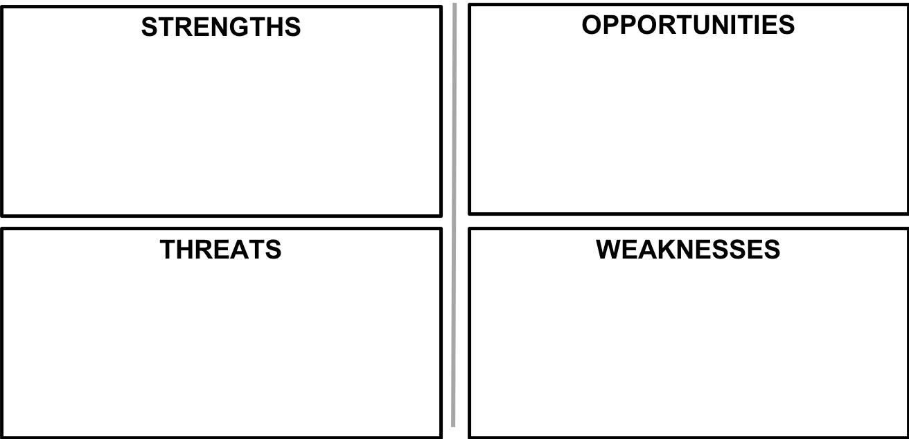

Slide 20
SWOT and Decision-Making
Strengths - Opportunities:
How can I use my strengths to take advantage of the opportunities I identified?
Strengths – Threats:
How can I use my strengths to minimize the threats I identified?
Weakness – Opportunities:
How can I manage/minimise my weaknesses so I don’t compromise the opportunities I identified?
Weakness – Threats:
How can I manage/minimise my weaknesses so I completely avoid the threats I identified?

Slide 21
Five Finger Competition
Hold up your hand with all five fingers extended.
I will ask you a set of questions – if your answer is ‘Yes’ then lower that finger.
The first person to get five ‘Yes’ answers wins!

Slide 22
Module 3:
The Ideal Leader Within You

Slide 23
Building The Ideal Leader Within You
6
1
2
5
4
3

Slide 24
Compassion
Bring attention or awareness to recognise that there is suffering
Feel emotionally moved by that suffering
Wishing there to be relief from that suffering
A readiness to take action to relieve that suffering
SELF
OTHER

Slide 25
Clarity of Thought
Do one thing at a time – do not multi-task
Increase your vocabulary to express with more clarity and distinguish between things
Keep the ‘where’ (the goal) clear
Write things down

Slide 26
Positive Mindset
Practice Gratitude to defeat Grievances
Practice Respect to overcome Regrets
Tap into your Aspirations to conquer lack of motivation / interest
Use Faith to beat your fears and doubts

Slide 27
Knowledge / Competence
Commit yourself to your chosen area
Challenge yourself through practice and action
Take feedback from mentors who have the competency you desire
Align purpose, approach and attitude

Slide 28
Inspiring
Have enthusiasm for what you do and for life
Think of and present possibilities that others are not thinking of, or feel are not attainable
Accept. Approve. Believe in others
Smile. A lot

Slide 29
Persuasion
Practice making the right choice, even if it is the difficult one. You need to be convinced first
Adapt to others’ learning preferences, their values and their ultimate goals
Use the power of stories
Focus on the greater good

Slide 30
Module 4:
Communication in Teamwork

Slide 31
COUNTING
Count up to 10 taking turns at random, with no two people speaking at the same time.
If two people speak at the same time, even for a second, the group must start over at number 1.

Slide 32
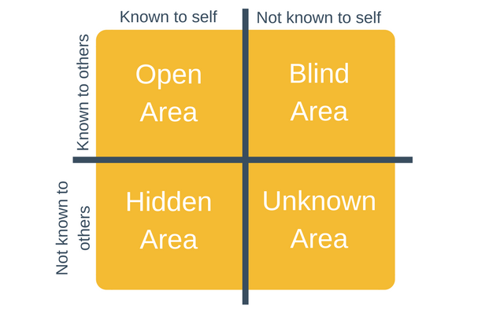
Group Communication Model: The Johari Window

Slide 33
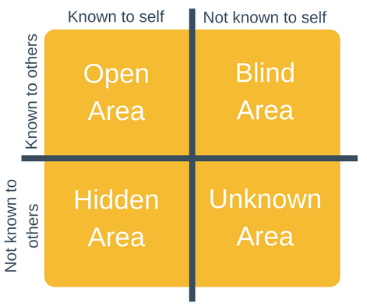
The Johari Window
In a high-functioning team, ideally you want to focus on expanding which area?

Slide 34
The Johari Window
By decreasing the blind area
HOW will you expand the Open Area?

Slide 35
The Johari Window
By decreasing the blind area
But HOW will you decrease the Blind Area?
Through FEEDBACK

Slide 36
The Johari Window
Who loves getting unsolicited feedback?
Not many. If any.

Slide 37
The Johari Window
As a team member:
Actively solicit feedback from other team members and the leader.
And actively listen to the feedback
By decreasing the blind area
As a leader:
Actively encourage team members to solicit feedback from each other and from yourself.

Slide 39
The Johari Window
By decreasing the blind area
HOW else will you expand the Open Area?
By decreasing the hidden area

Slide 40
The Johari Window
By decreasing the blind area
But HOW will you decrease the Hidden Area?
Through
SHARING INFORMATION
By decreasing the hidden area

Slide 41
The Johari Window
By revealing information about yourself in a group you can increase ________ within the group

Slide 42
The Johari Window
By revealing information about yourself in a group you can increase TRUST within the group

Slide 43
The Johari Window
As a team member:
Be prepared to actively reveal and share about yourself to members and the leader.
By decreasing the blind area
As a leader:
Actively encourage every team member to reveal and share with each other.
Make sure you do it yourself!
By decreasing the hidden area

Slide 45
The Johari Window
HOW do you move from Unknown Area to the Open Area?
Observation
Shared Discovery
Self-discovery

Slide 46
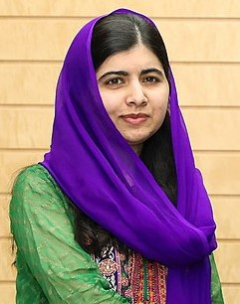
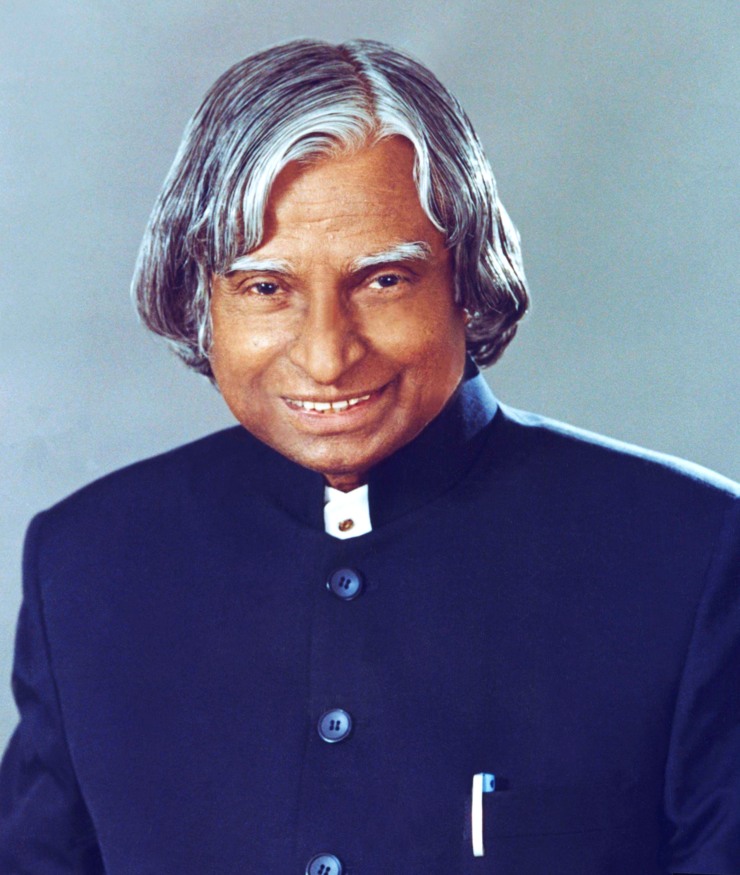
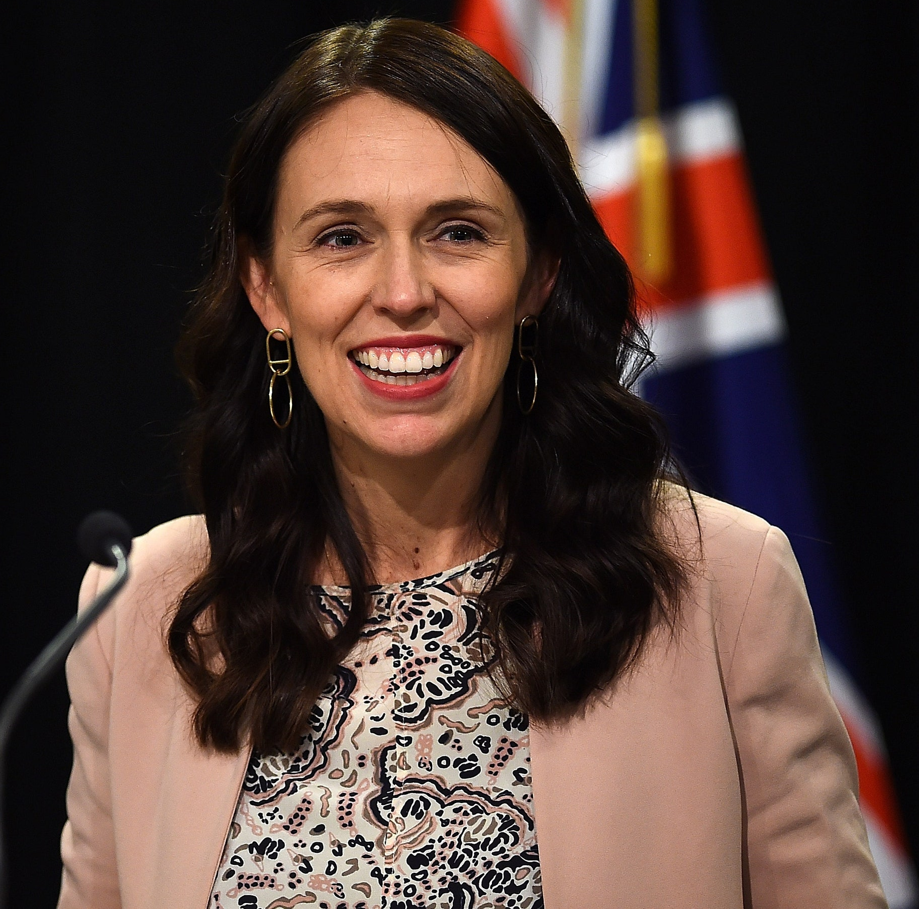
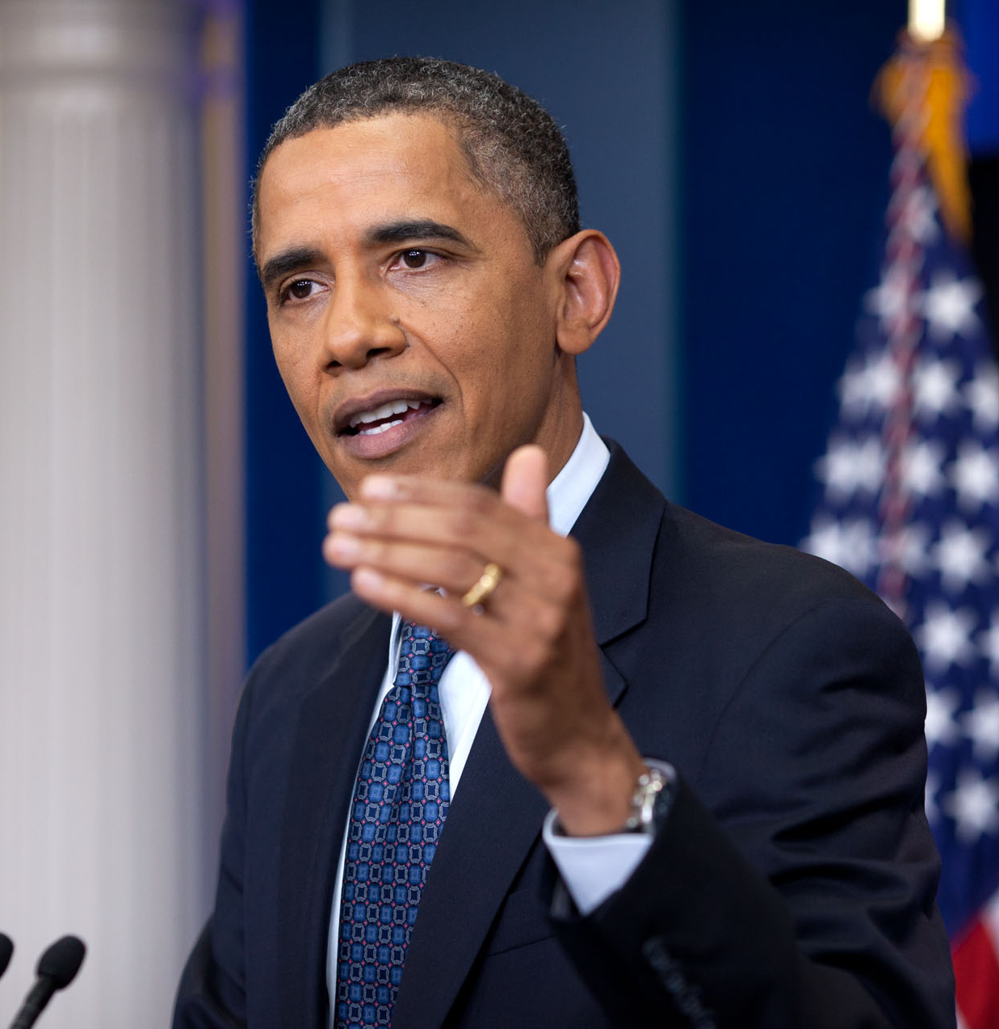
Great Communicators
M Yousafzai| APJ A Kalam| J Ardern| B Obama
Courage| Clarity | Transparency | Humour

Slide 47
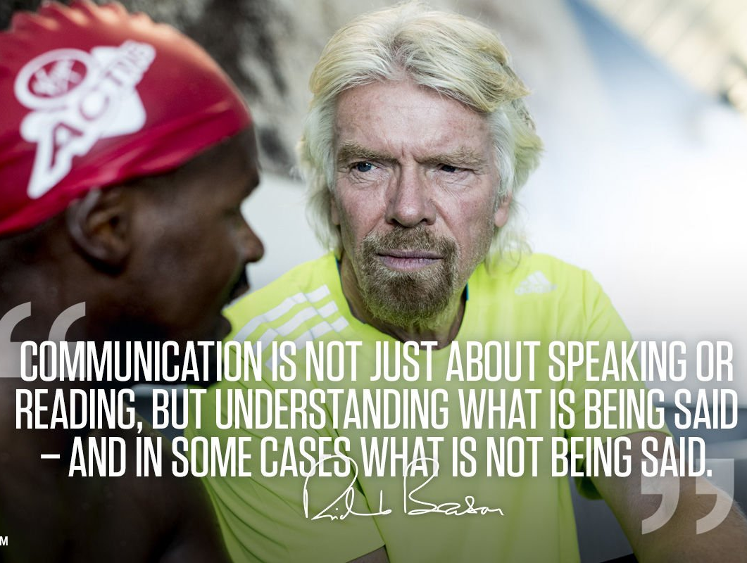
Great Communicators
Sundar Pichai | Simplifying the complex
Richard Branson | Communicate with your ears

Slide 48
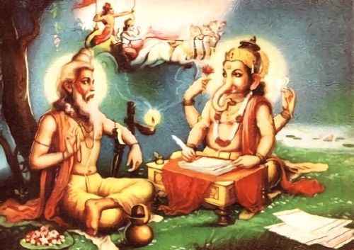
Great Communicators
Ved Vyasa | Precision - Lord Ganesha |Clarity
Lord Hanuman| Brevity

Slide 49
The Johari Window: Exercise
Choose ONE Receiver. In this case, receiver is ME. The receiver will choose 12 adjectives that best describe themselves.
TEAM / GROUP: All of you. From the same list of adjectives pick 8 that the group believes describes the receiver well.
Draw the quadrant and fill it:
Those adjectives that appears in both lists, place it in OPEN AREA.
If an adjectives that appears in the RECEIVER’s list, but NOT in the GROUP’s, place it in HIDDEN AREA.
If an adjectives that appears in the GROUP’s list, but NOT in the RECEIVER’s , place it in BLIND AREA.
Adjectives that don’t appear in either quadrant can go in the UNKNOWN AREA
Discuss:
Adjectives that appear in the OPEN AREA
Disclosure: RECEIVER to choose one adjective from the HIDDEN AREA and talk about it with their group
Feedback: GROUP to choose one adjective from the BLIND AREA and talk about it with the INDIVIDUAL
Discovery: From the UNKNOWN AREA choose 1-2 adjectives – does the RECEIVER feel it applies to them? Does the GROUP feel it applies to the RECEIVER?
10-15 minutes

Slide 50
The Johari Window: List of adjectives
able
accepting
adaptable
bold
brave
calm
caring
cheerful
clever
complex
confident
dependable
dignified
empathetic
energetic
extroverted
friendly
giving
happy
helpful
idealistic
independent
ingenious
intelligent
introverted
kind
knowledgeable
logical
loving
mature
modest
nervous
observant
organized
patient
powerful
proud
quiet
reflective
relaxed
religious
responsive
searching
self-assertive
self-conscious
sensible
sentimental
shy
silly
spontaneous
sympathetic
tense
trustworthy
warm
wise
witty

Slide 51
The Johari Window: List of adjectives
Known to Receiver
Unknown to Receiver
OPEN AREA
BLIND AREA
Known to Team
HIDDEN AREA
UNKNOWN AREA
Unknown to Team

Slide 52
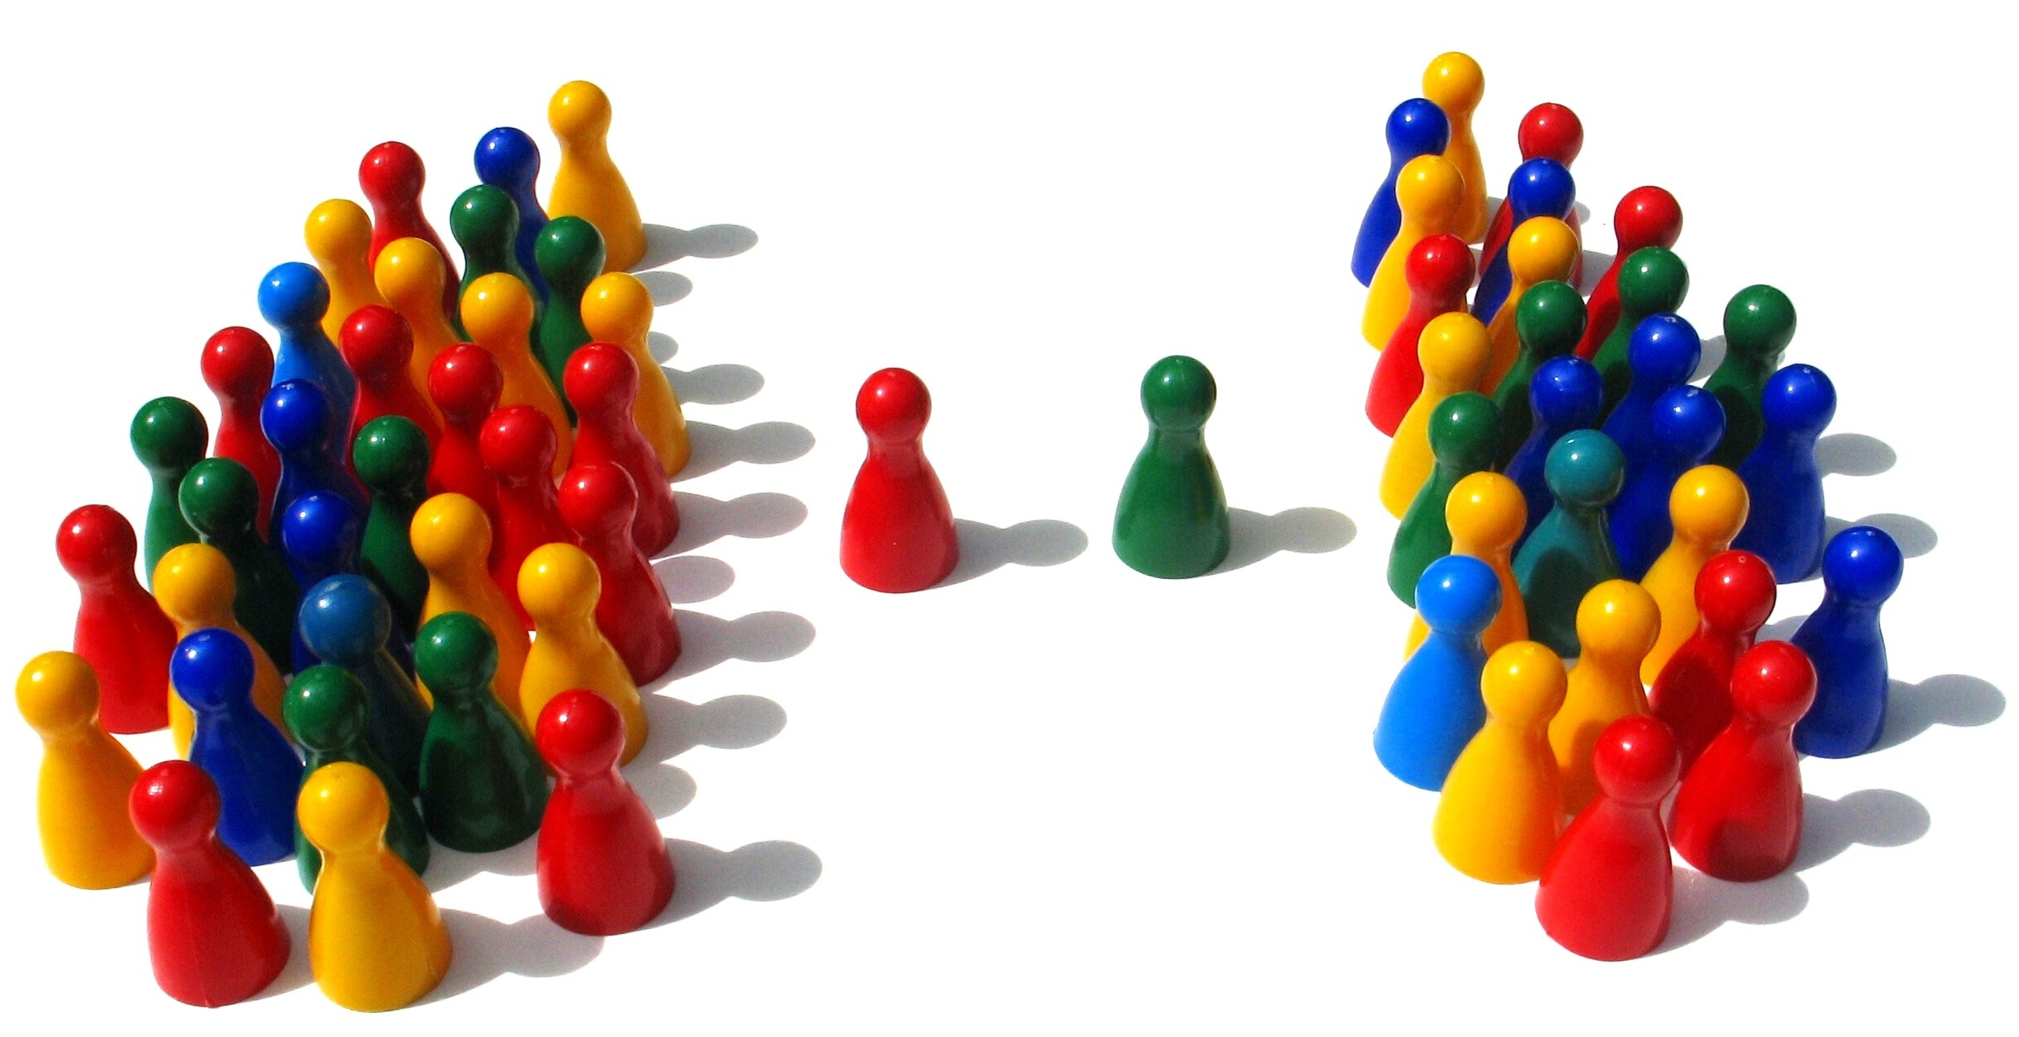
The Johari Window: Another Use
Collaborative
Adversarial
Team Building
Negotiations

Slide 53
Key Takeaways
As a leader actively encourage team members to solicit feedback and share information about themselves
As a team member, actively solicit feedback from the team and the leader and share information about yourself with the team and leader
Self-discovery, Observation and Shared Discovery are essential towards a high-functioning team
Feedback and Share
Notes:
1 minute per participant – total 10 mins

Slide 54
WHO AM I?
I am an animal.
Guess who I am by asking me Yes / No questions.
You each get a turn to ask me a question. The objective is to listen CAREFULLY to each question and the answer
I give.
YOU ARE ALL ONE BIG TEAM!

Slide 55
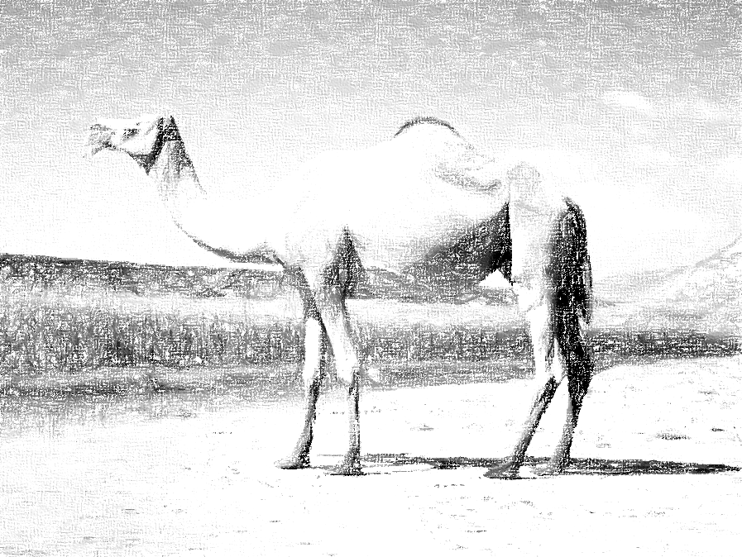

Slide 57
Module 5:
Conflict Resolution

Slide 58
Source(s) of Conflict
How does conflict arise in teams?

Slide 59
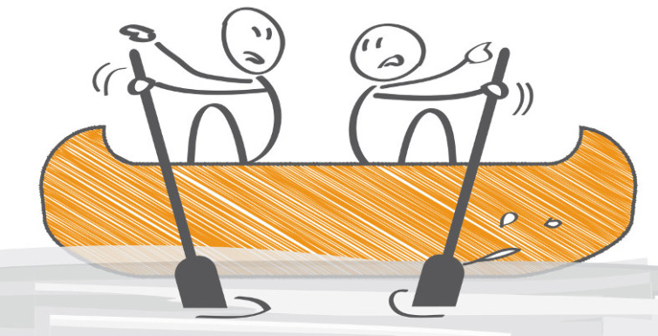
Source(s) of Conflict
Miscommunication
Poorly defined roles
Lack of goals / Clarity on goals
A lack of feedback
Culture misalignment
Personality differences

Slide 60
Types of Conflict
What are the different types of conflict in teams?
Task-based
Goals, Tasks, Allocation of resources etc
Relationship - based
Personality conflicts, jealousy, insecurity, annoyance

Slide 61
The objective: Project Action Plan
Think Big (Project) | Act Small (Action Items) | Move Quick (Timeline) | Person Responsible | Task Dependencies | Progress
< your project>
CONFLICTS & PROBLEMS

Slide 62
Assertiveness
How assertive are you?

Slide 63
Cooperativeness
How cooperative are you?

Slide 64
How can we address conflict?
Competing
Assertive but not co-operative
Collaborating
Assertive but not co-operative
Compromising
Moderately assertive and moderately co-operative
Avoiding
Not assertive and not co-operative
Accommodating
Not assertive but co-operative

Slide 65
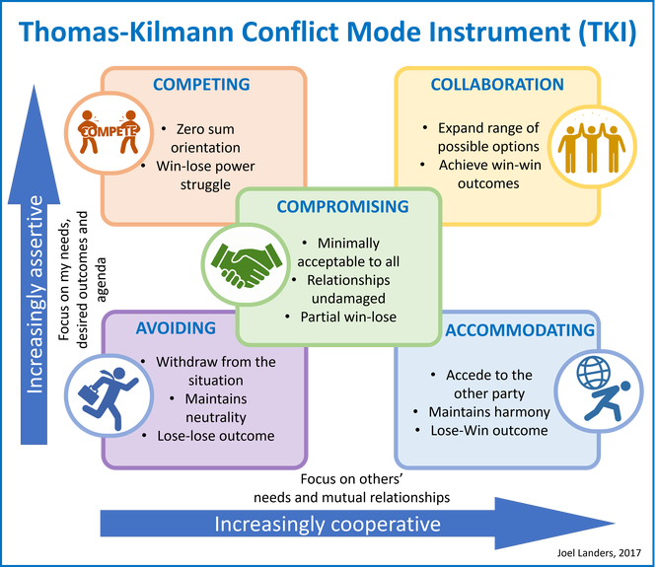
Thomas Kilman Conflict Modes

Slide 66
When to use which mode
Competing (my way)
Emergency situations, quick decisive action required
Effective approach for unpopular decisions
Negative impact on individual team members
Don’t want conflict resolved.
Collaborating (our way)
High stakes conflicts
Resolution is highly important
Examples: Negotiation and Mediation
Both parties can gain and lose, high interdependence
Compromising (halfway)
Both arguments have equal rationale
Participants are equal in status
Both sides willing to give something up
Time is a luxury, urgent resolution required.
Avoiding (no way)
If conflict is trivial (e.g: being left of an email broadcast)
If more information is awaited
If leader wants to handle it informally
Does not interfere with team performance
Accommodation ( your way)
When the other party is actually right (get the ego out of the way first!)
Don’t feel strongly about the result
To gain goodwill from the team member
To keep the whole team functioning and co-operating

Slide 67
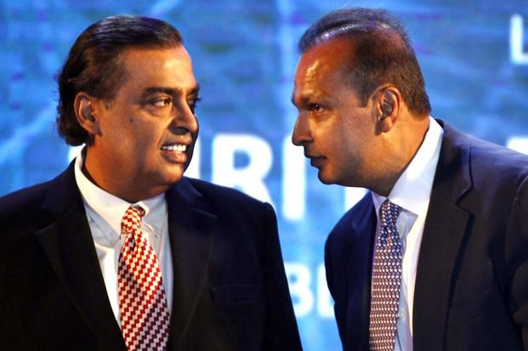
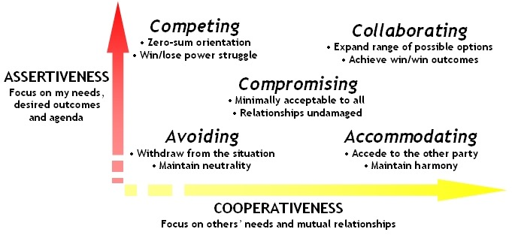
Conflict: Examples
Conflict resolved through Accommodating (Mukesh)

Slide 68
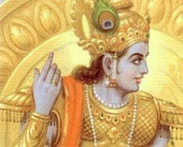
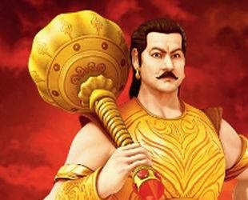
Conflict: Examples
Compromising
Competing
Conflict NOT resolved through negotiation.
Conflict resolved through greater competing (assertiveness).

Slide 69
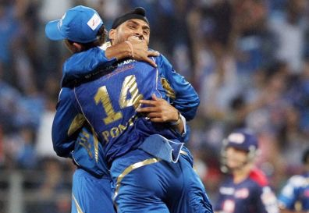
Conflict: Examples
Conflict resolved through Compromising / Collaborating

Slide 70
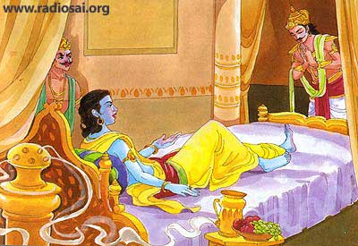
Conflict: Examples
This particular conflict resolved through Krishna collaborating

Slide 71
Conflict: Exercise
Which conflict resolution mode will you use?
You are the CEO and you want to limit the number of drinks served
at every Friday’s beer-O’Clock.
Most members of your organisation are not for it.
Competing.

Slide 72
Conflict: Exercise
Which conflict resolution mode will you use?
You are the CEO and your marketing manager complains of lack of interest from one of his team members, person A.
Person A says he feels unrecognised and invisible.
Collaborating.

Slide 73
Conflict: Exercise
Which conflict resolution mode will you use?
You are part of a community team running a fundraising project. You ask the treasurer to release more funds to help you market it as you have allocated your marketing funds.
The treasurer says budget has been reached and that you be more efficient and cut costs.
Accommodating.

Slide 74
Conflict: Exercise
Which conflict resolution mode will you use?
Team member A who is always punctual, complains that Team member B is always 2 minutes late to every meeting.
Team member B is a single parent who has to drop his kids off to day care. Team member B is a high-performer and Team member A has performance issues.
Avoiding.

Slide 75
Conflict: Exercise
Which conflict resolution mode will you use?
You have one hour to go before you present to the grants committee for your community project. You want a detailed financial projections slide.
But the financial projections slide is missing. Team member in charge of that slide is sick but you ask them to prepare an overview slide, not a detailed one.
Compromising.

Slide 76
Key Takeaways
How you choose to address conflicts depends on your assertiveness and cooperation
The above results in five modes of conflict resolution:
Avoiding
Competing
Compromising
Accommodating
Collaborating
Great conflict resolvers adapt their modes with the situation
Notes:
1 minute per participant – total 10 mins

Slide 78
+
+

Slide 79
+
+

Slide 80
Module 6:
Community Projects: Raising Awareness

Slide 81
Promotions
How will you promote your community project to your target audience?
Notes:
1 minute per participant – total 10 mins

Slide 82
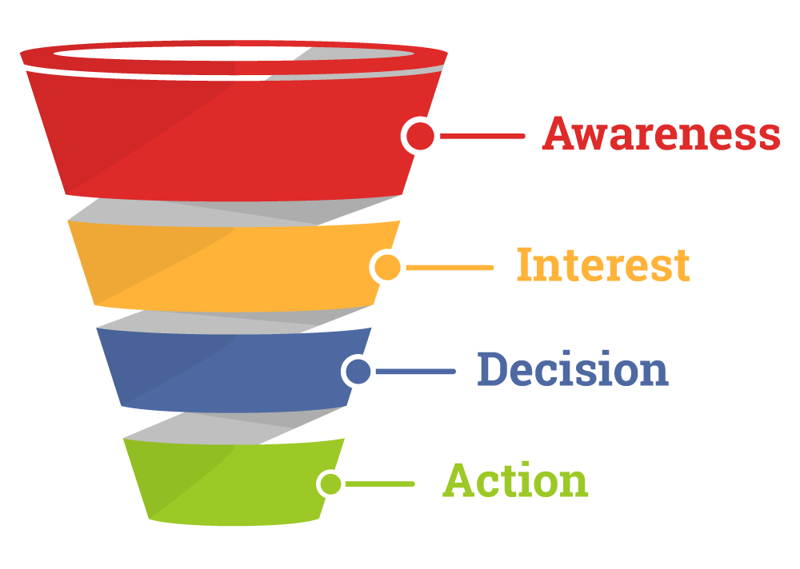
Customer Buying Journey
Awareness
This could be (lack of) awareness of you, your solution to their problem and the problem itself.
Interest
This is where the prospect begins to develop associations towards your brand, your products/services etc.
A positive association is in the form of engagement
Decision
This is the ‘hands on the wallet’ moment where they have decided to address their needs.
They choose you over their other options.
Action
This is ‘conversion’ where the prospect performs the desired action (sale, booking etc)

Slide 83
Awareness Through The Ages
1700s
1800s
1900s
2000s
How will you promote your community project to your target audience?
Notes:
1 minute per participant – total 10 mins

Slide 84
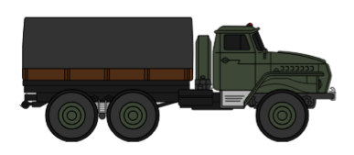
Content – Medium - Audience
CONTENT
MEDIUM
AUDIENCE

Slide 85
Promotional Mix
Which medium does your target audience consume?
HOW DO I SPREAD THE WORD ABOUT WHAT I HAVE TO SELL?
Notes:
1 minute per participant – total 10 mins

Slide 86
Key Takeaways
Understand the purchase journey your target audience will undertake
(e.g Awareness -> Interest -> Decision -> Action)
Pick advertising / promotional channels that your target audience will consume
Develop content (written, audio, audio-visual) that have the best chance of resonating with your audience
Notes:
1 minute per participant – total 10 mins

Slide 87
In Summary…

Slide 88
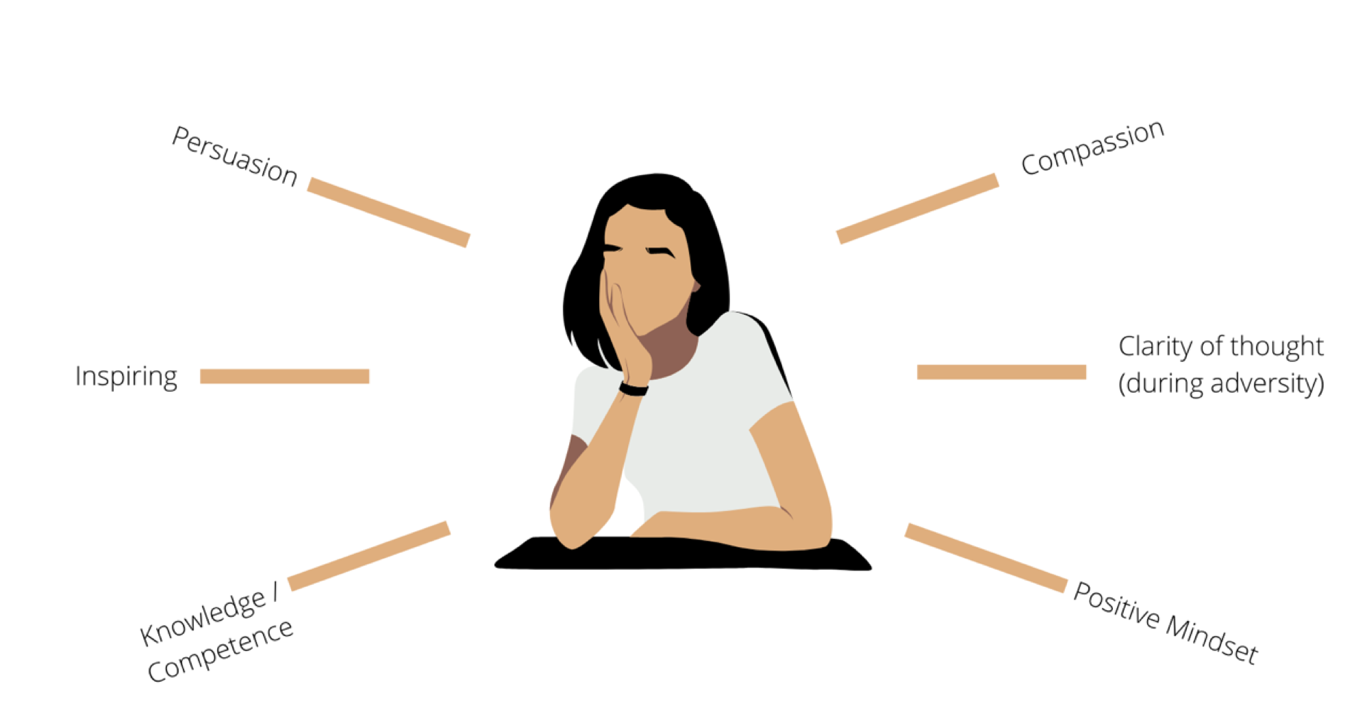
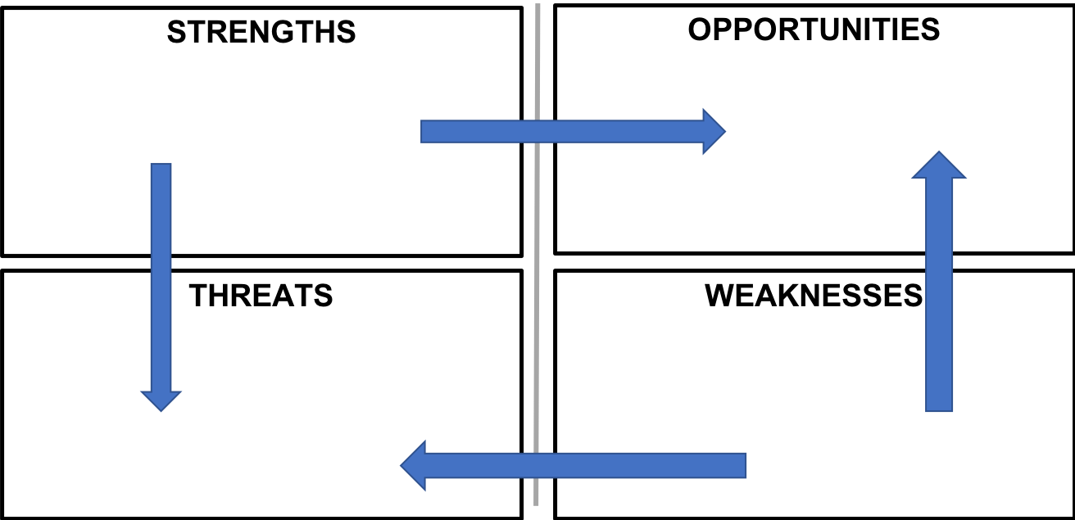
Learn to Lead – Part 2: What did we learn?
Decisions
YOU
Feedback
Sharing
Notes:
1 minute per participant – total 10 mins

Slide 89
Learn to Lead – Part 1: What did we learn?
Qualities of an ideal leader:
Compassion
Clarity of Thought
Positive Mindset
Knowledge / Competence
Inspiring
Persuasion
Vision: The 4-step test
Compelling
Image
Achievable
Future
Goals
Now-Where-How
BSQ Model
3B Leadership Framework: Belief in Leadership
Belief-> Behaviour->Business (Outcome)
Teamwork in Leadership
Belbin Team Roles
4 Stages of Teams
Decision-Making in Leadership
Leadership Styles
Types of Decisions
Notes:
1 minute per participant – total 10 mins

Slide 90
Module 7:
Project Presentations

Slide 91
Thank You!
Q&A
Notes:
1 minute per participant – total 10 mins

